Slide 1
PupPlanner User Instructions

Slide 2
Welcome to PupPlanner
This guide will help you navigate through the app to manage your pet(s) activities, health tests, reproduction records, and more.
With an intuitive app interface, you will become a PupPlanner master.

Slide 3
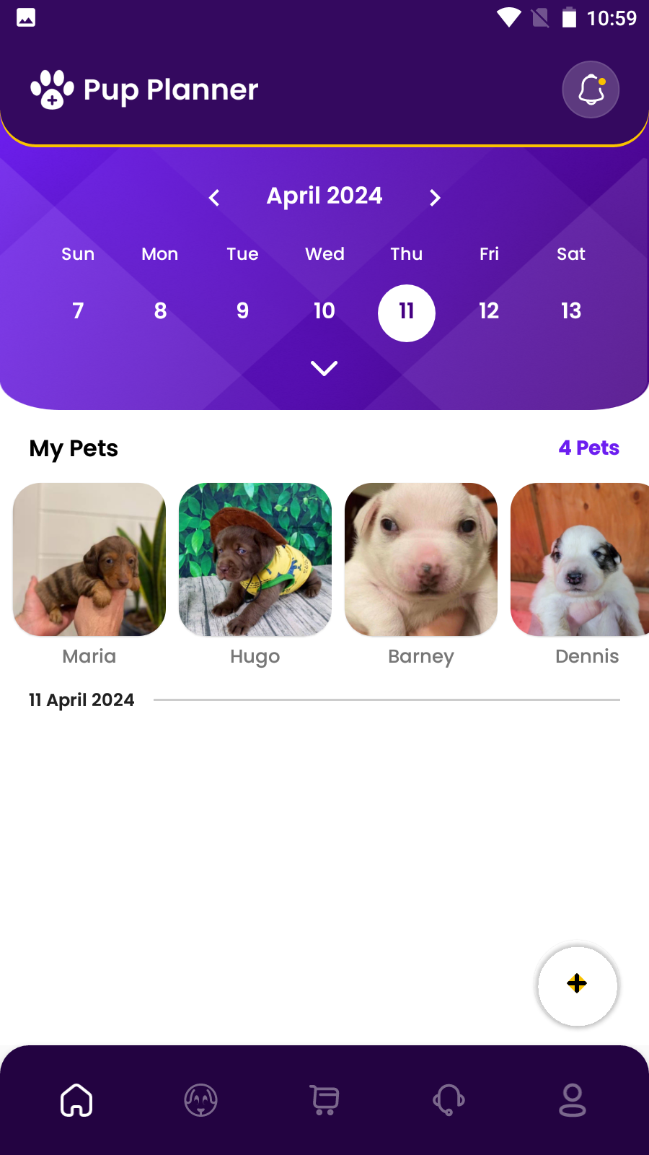
Home Page
The homepage displays all scheduled activities for your pets
Features include:
Date Selection
Pet Selection
Add activities

Slide 4
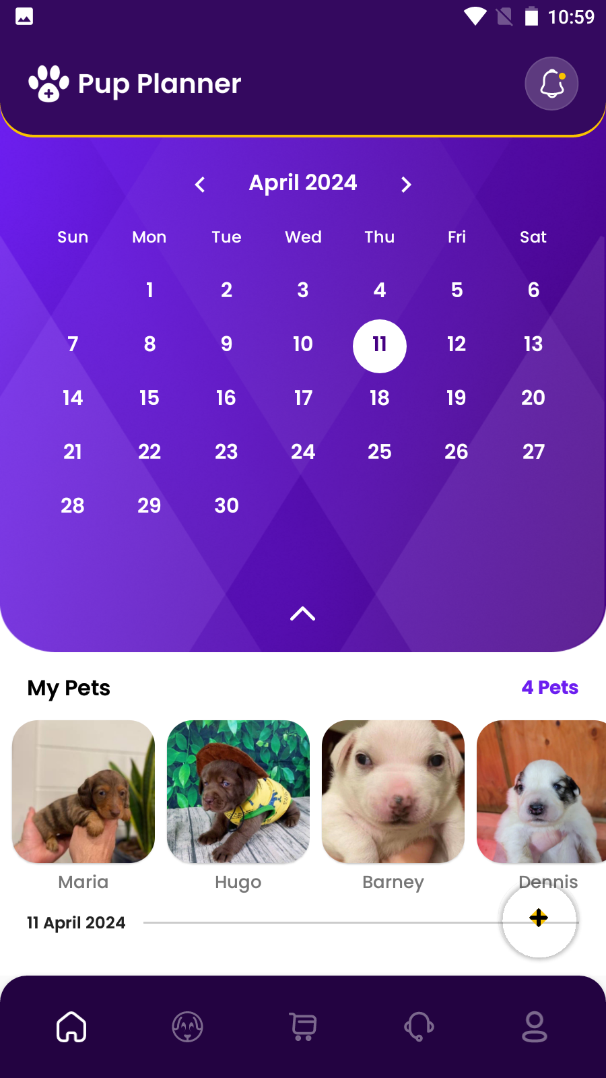
Home Page: Date Selection
Use the top date picker to view activities for a specific date.

Slide 5
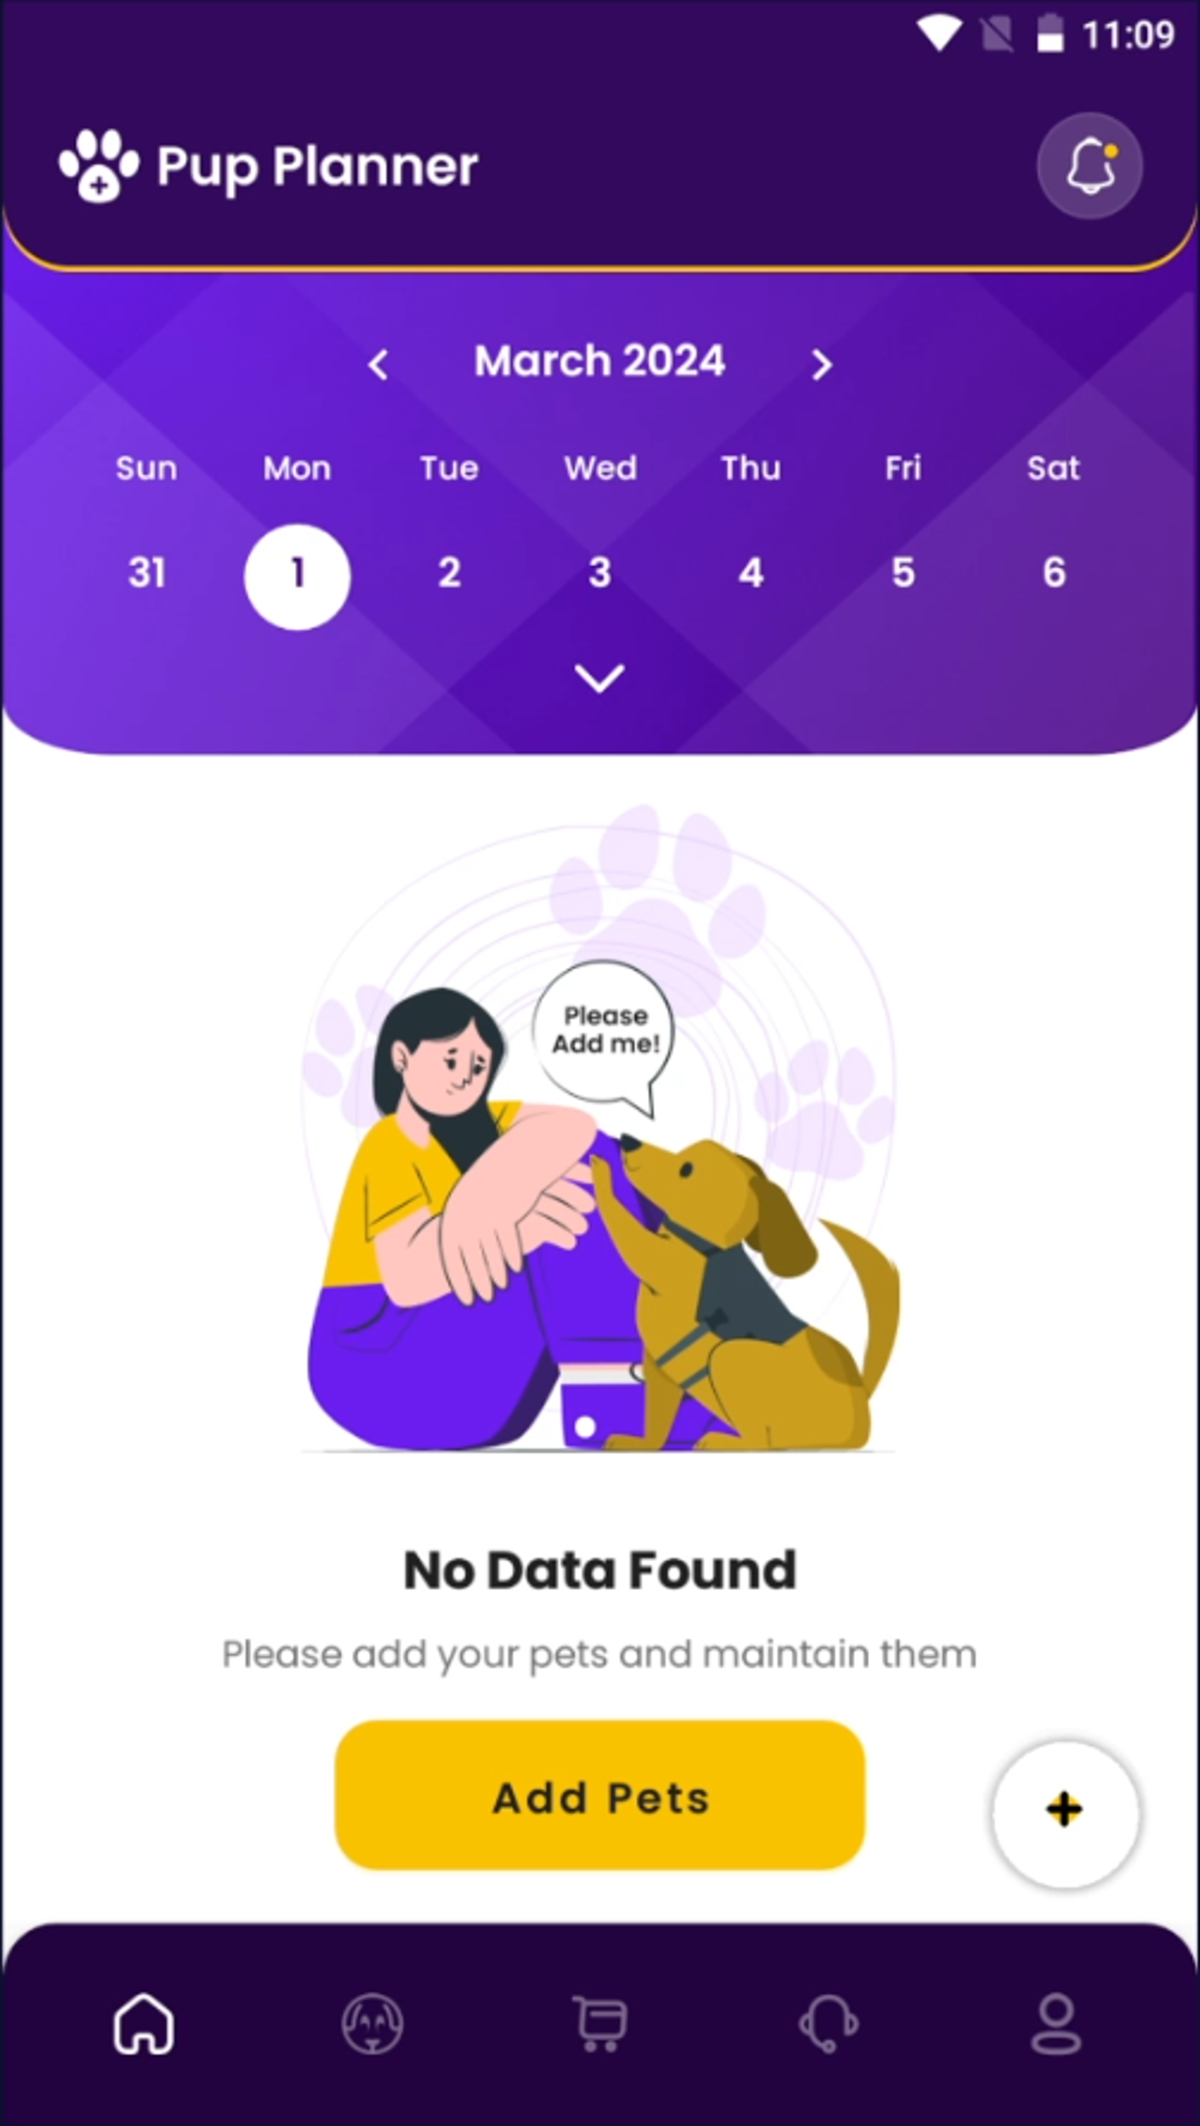
Home Page: Pet Selection
To add your first pet, click the ‘Add Pet Button’
Now you can choose a pet in the middle section to see activities specific to that pet.

Slide 6
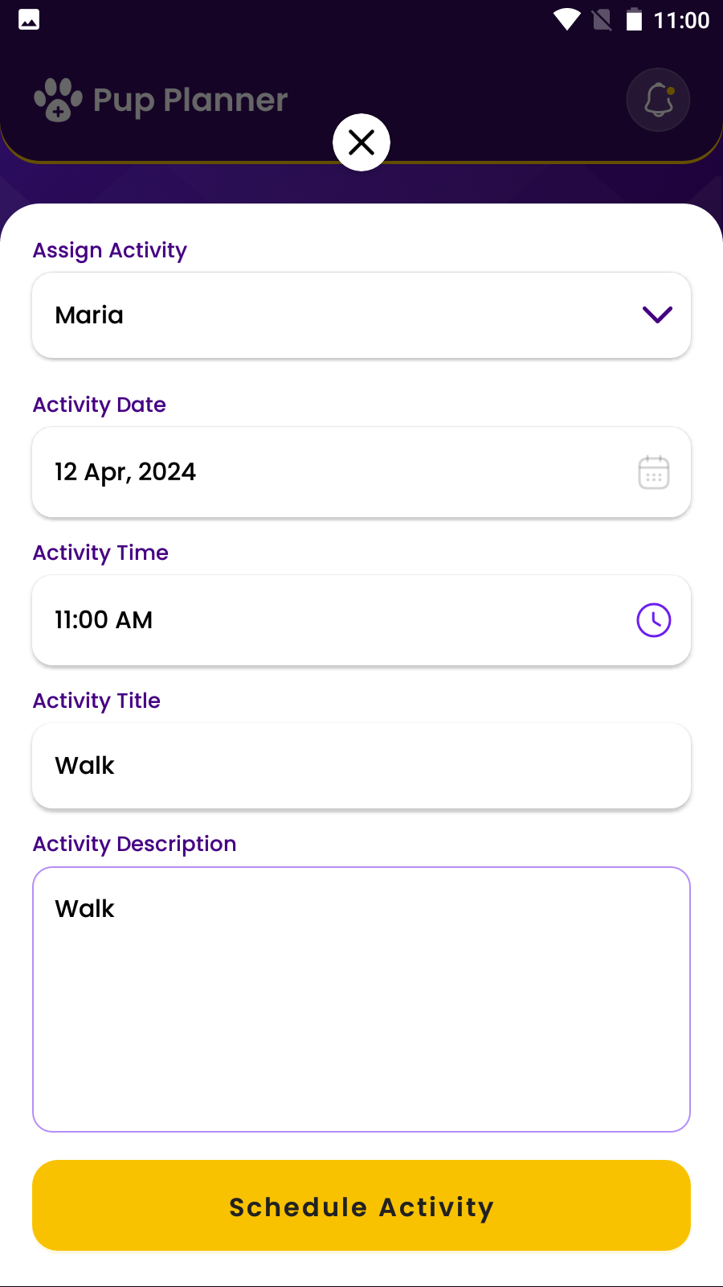
Home Page: Add Activities
For all pets: Select “All” from the drop down to add activities for all pets.
For an individual Pet: Choose a single pet, like Zena, to schedule an activity.
For multiple Pets: First select one pet (e.g., Zena), then another (e.g., Alf) to create an activity for both. Reset by selecting “All” and then re-select the desired pets.

Slide 7
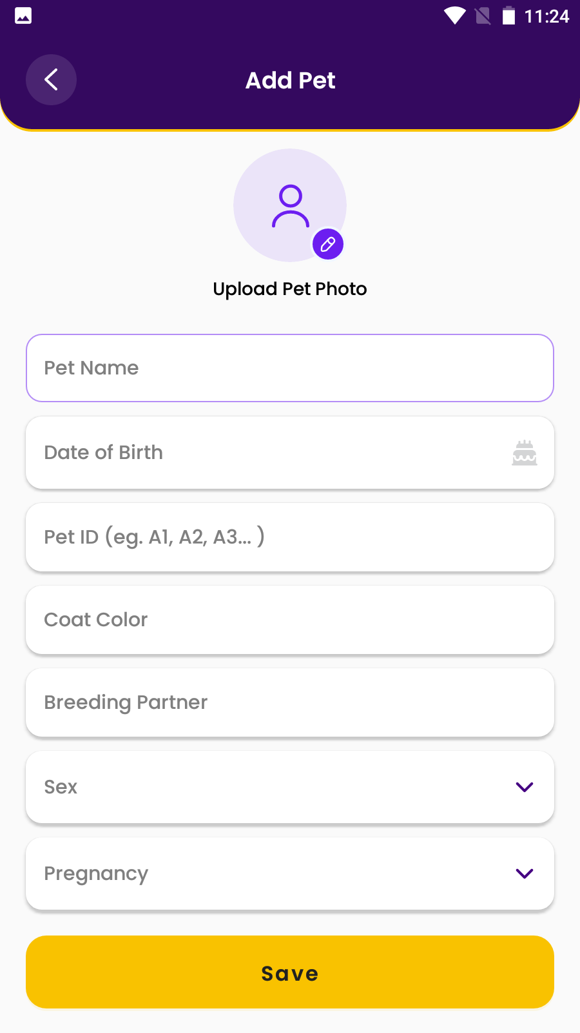
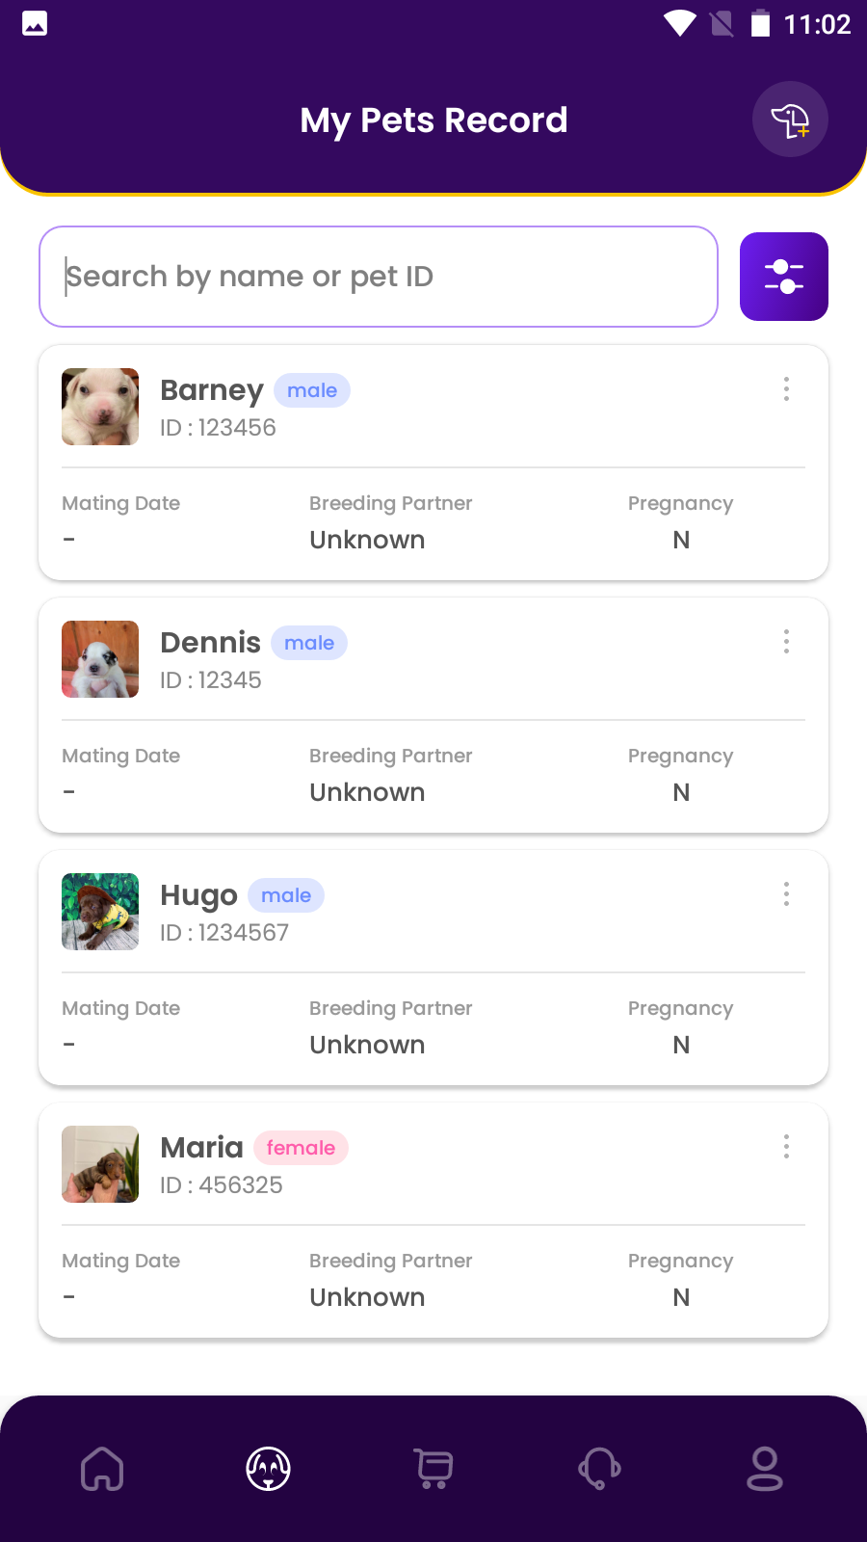
Pets Page
To continue adding a new pet, click on the button dog icon at the top of your screen.
Here you can edit:
Pet name
Photo
Coat Color
Breeding Partner
Sex and Pregnancy
Please note, Pet ID cannot be changed once pet is saved.
Click the search bar or use the filters to search for pets by name or other identifies

Slide 8
Pet Profiles
When you click on a pet on the pet page, you will open up that pet’s profile.
Features:
Activity page
Test History
Reproduction History
The following slides will go in depth on navigating the Pet Profiles features

Slide 9
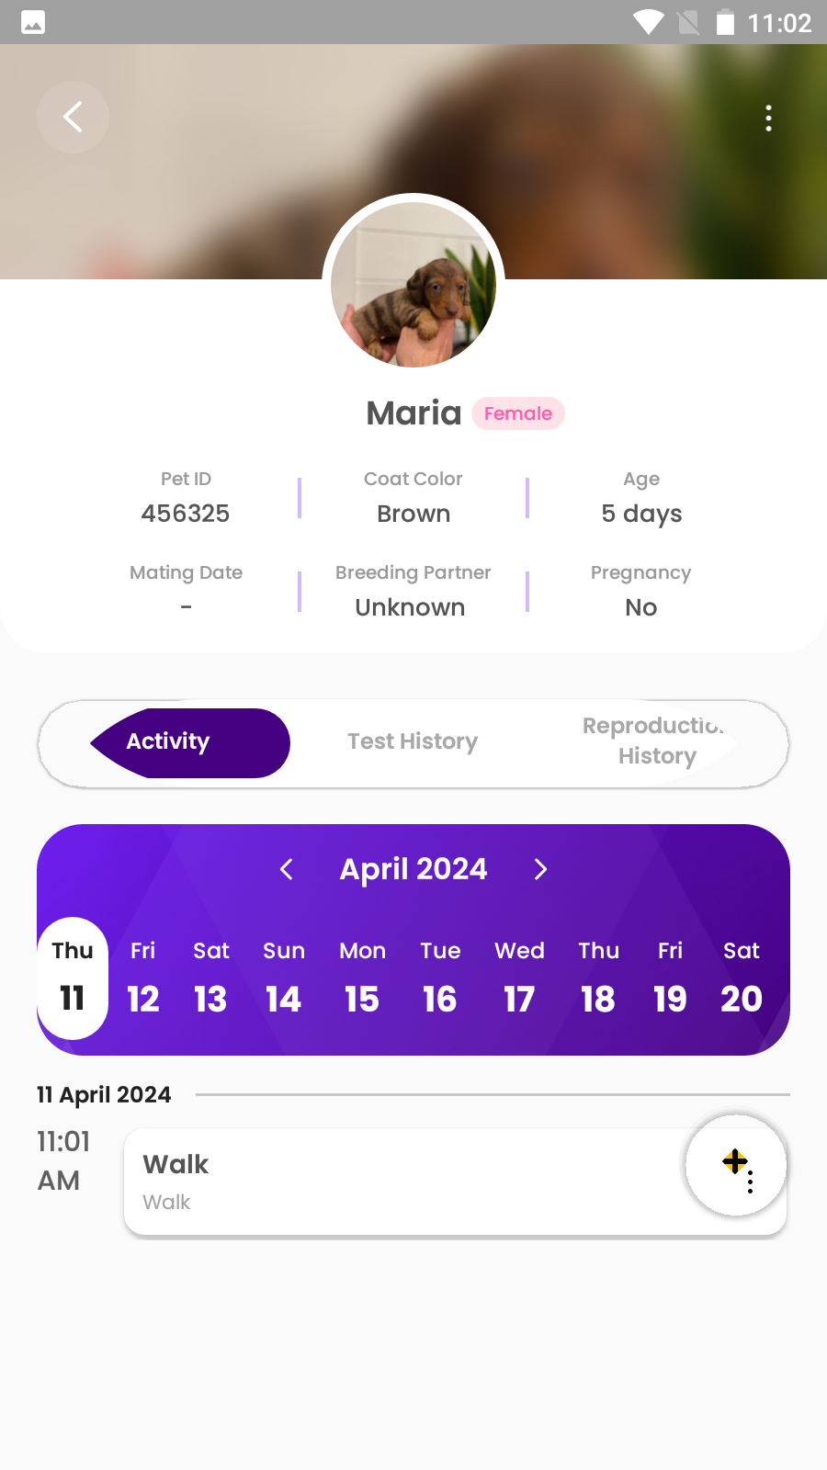
Pet Profiles: Activity page
Here you can set activity for an individual pet.
This is same data shown on the Homepage, offering you options to take quick notes on the homepage and adding more details on the activity page

Slide 10
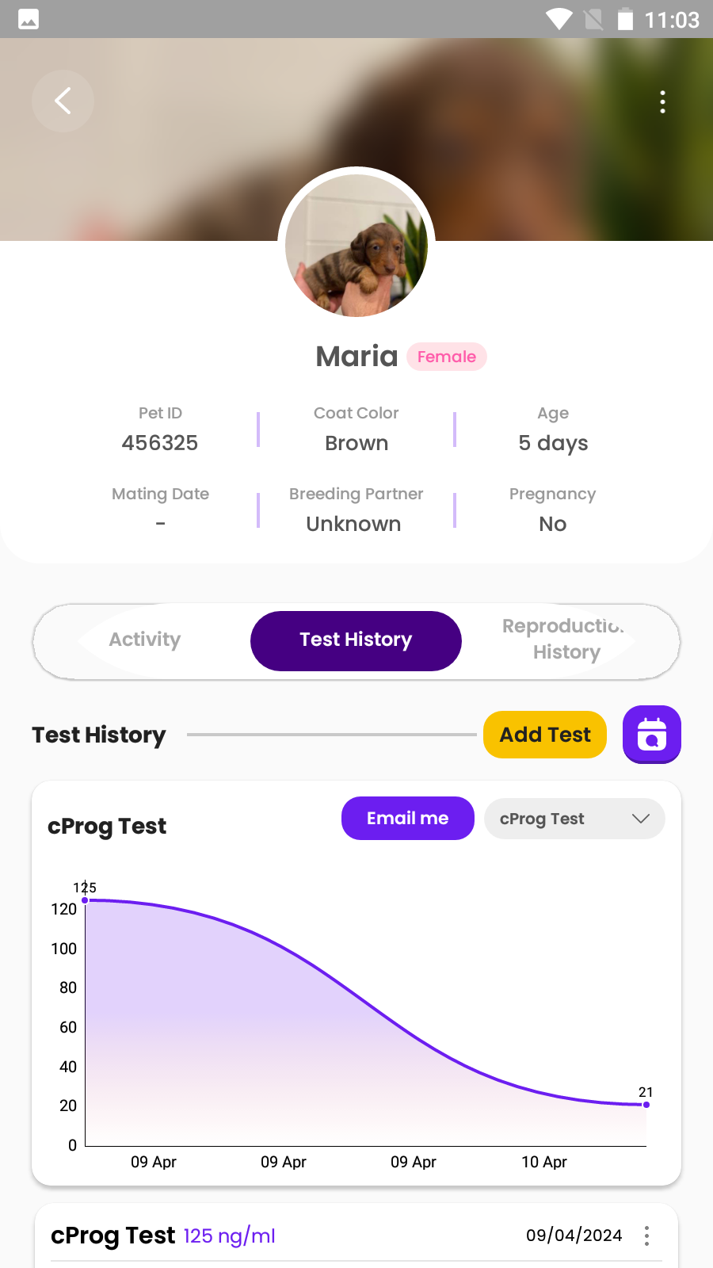
Pet Profiles: Test History
This page offers 4 specific features
Add test: choose from the test drop down (cProg or LH) and select the test or click ‘other’ to enter a different test.
Every test entered into ‘other’ will be saved into the drop down for future use. New tests cannot be deleted
Filter Test by Date
Email the test report to the email registered in the app
Select specific test to plot on a graph

Slide 11
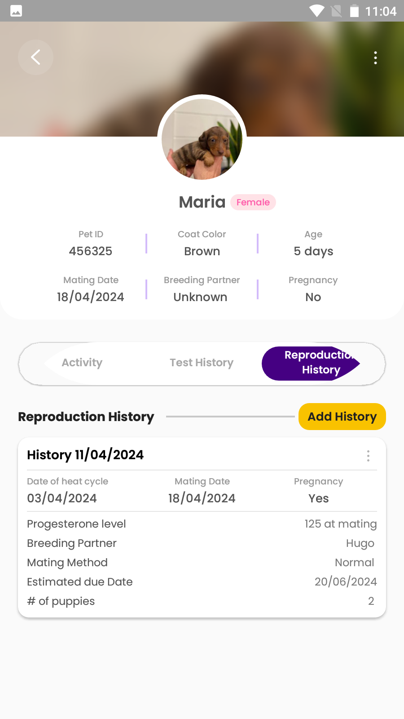
Pet Profiles: Reproduction History
The reproduction history includes 2 features:
Edit history by clicking the symbol in the upper right corner of each module
Add new history

Slide 12
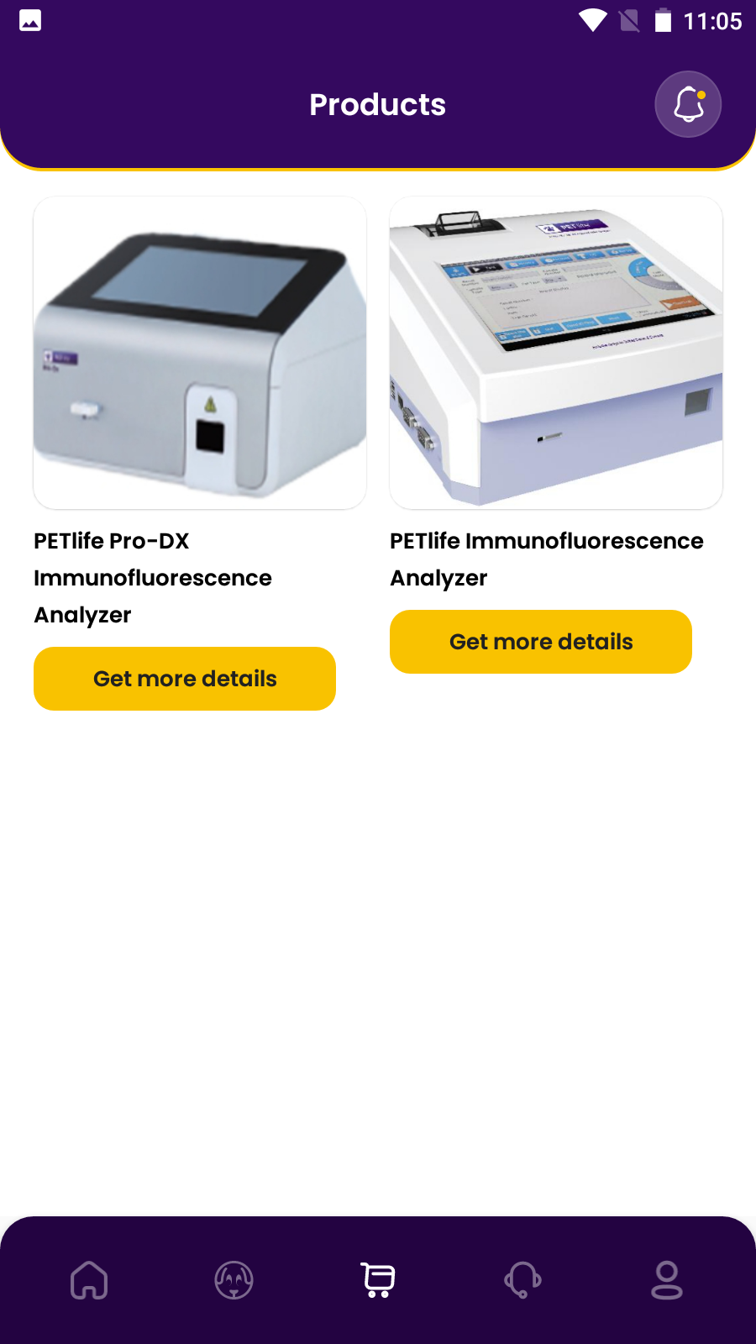
Product Page
If you click on the shopping cart logo in the menu row, you will find our product offerings for our analyzers
Currently, the app does not support in-app purchases. Should you wish to explore purchasing options or need further assistance with products, please reach out to us directly through the contact options provided in the app.

Slide 13
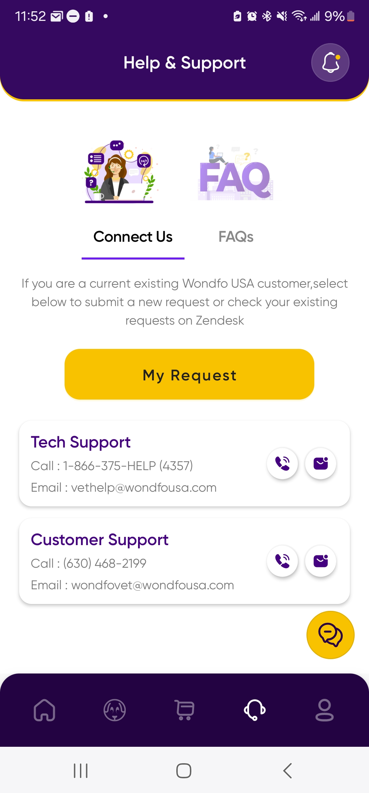
Help & Support Page
If you need to connect with us or have any questions, click on the headset icon.
Features available:
Connect with us
My Request – submit a request on Zendesk, our team will reach out to you as soon as possible
Call or Email Tech Support
Call or Email Customer Support
Online chat

Slide 14
Help & support page
Online chat: we maybe offline, but will get back
to you as soon as possible

Slide 15
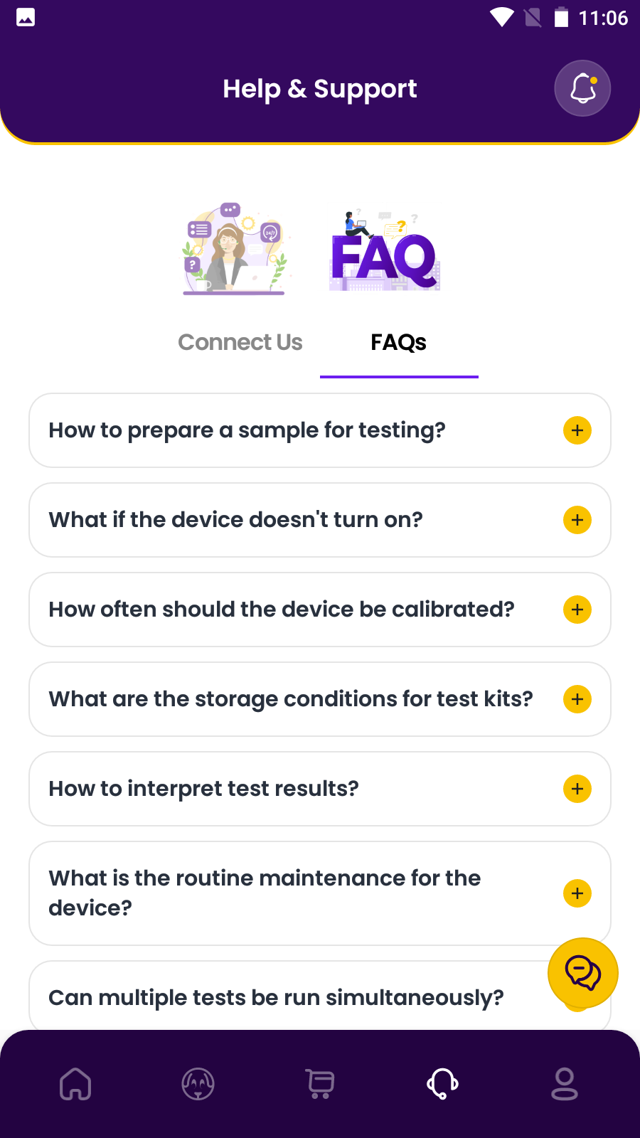
FAQs
This section is designed to provide quick answers to frequently asked questions about the app's features, troubleshooting steps, and general usage tips.
It's a great first stop for resolving common issues and learning more about how to make the most of the app's functionalities.

Slide 16
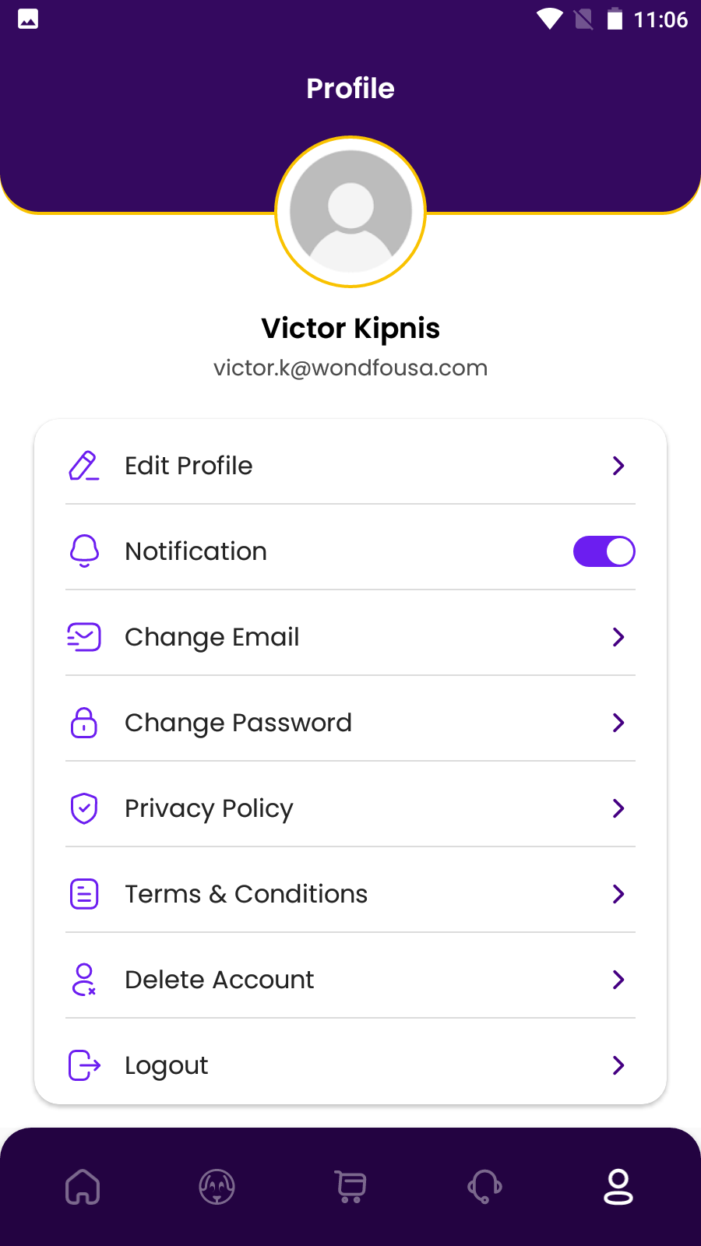
User Profile
Features
Personal Information: This area allows you to update your personal details, including contact information and preferences. It's important to keep this information current to ensure you receive the latest updates and communications from us.
Password Management: Secure your account by changing your password regularly. This page includes simple steps to update your password.
Privacy Policy and Terms & Conditions: Stay informed about your rights and responsibilities as an app user by reviewing our privacy policy and terms & conditions. It's crucial to understand how your data is used and protected within our app.

